Slide 1
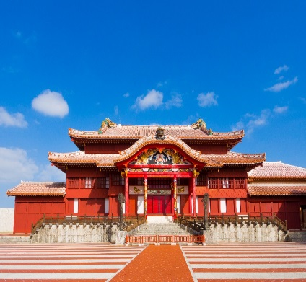
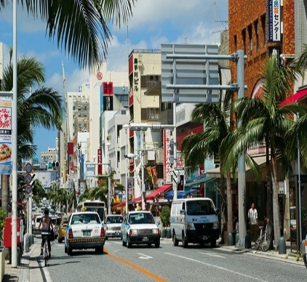
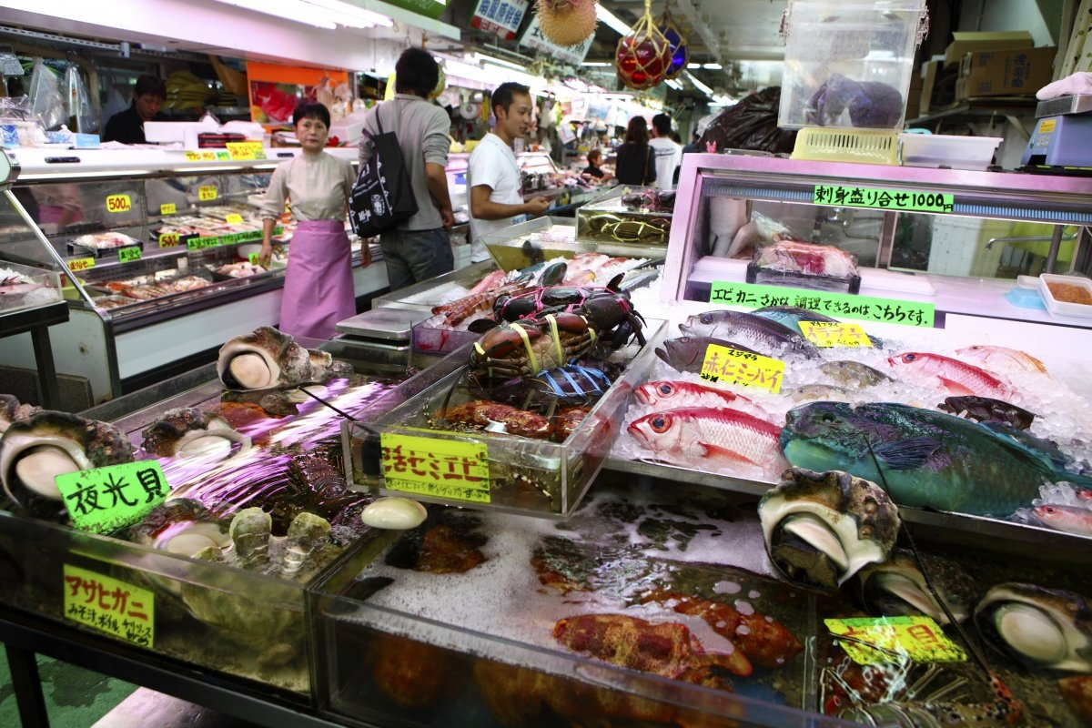
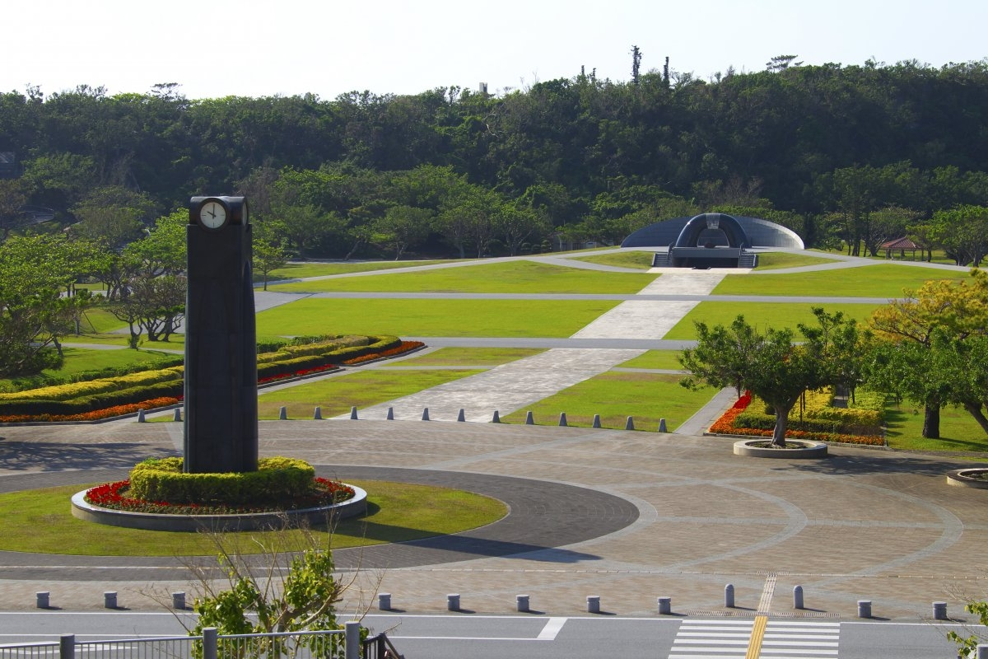
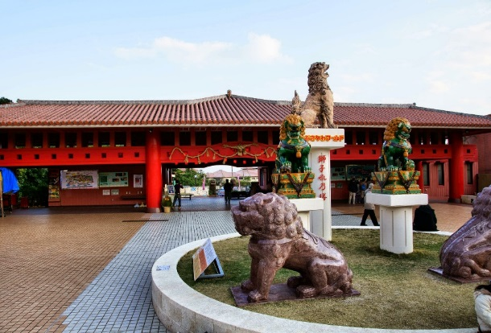
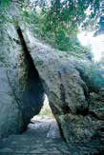
The reason why holding your MICE in Okinawa
Okinawa Island with its wealth of sightseeing
Recommended Course of
the Naha area
Centered on Kokusai Dori Street, called "the miracle mile" symbolizing Okinawa's reconstruction after the war, the town is a compact distillation of the charm of Okinawa, from daily life to art.
About 17 minutes
About 6 minutes
About 8 minutes
Shurijo Castle
Kokusai Dori Street
Makishi Public Market No.1
Tsuboya Yachimun Pottery Street
Recommended Course of
the Southern area
This area is steeped in timeless history and natural beauty, with its green forests with their freshwater airings, and the boundless ocean. Providing calm spirit, it's also a place where people pray for peace.
About 17 minutes
About 24
minutes
Peace Memorial Park
Okinawa World
Sefa-utaki sacred place

Slide 2
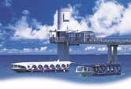
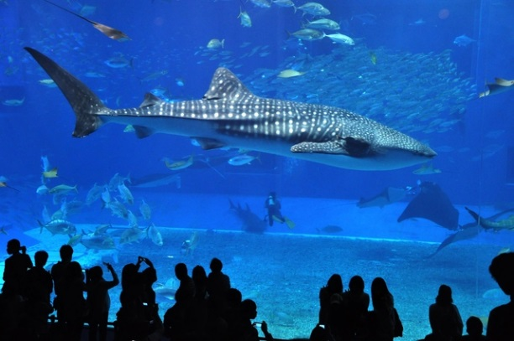
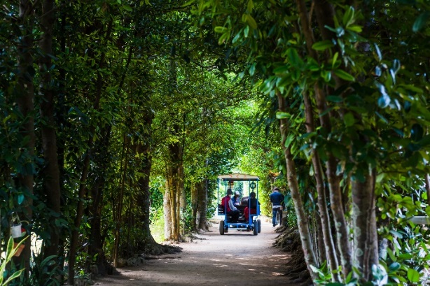
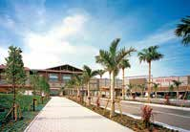
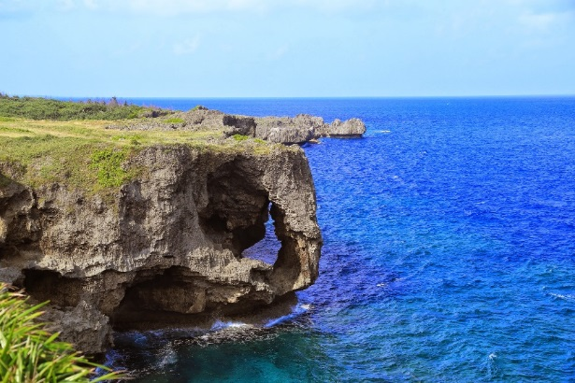
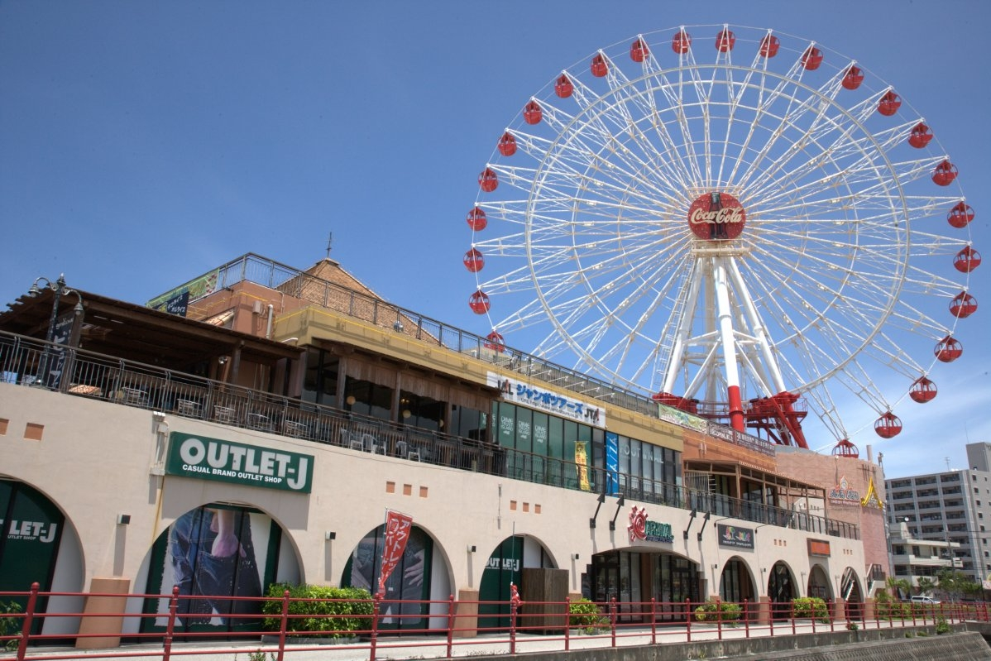
The reason why holding your MICE in Okinawa
Okinawa Island with its wealth of sightseeing
Recommended Course of
the Northern Area
This area is home to aboriginal forests where rare species thrive, with remarkably clear ocean. The rich natural beauty and friendly people are typical of old Okinawa.
About 47 minutes
About 21 minutes
Busena Marine Park
Okinawa Churaumi Aquarium
Bise-Fukugi Tree Road
Recommended Course of
the Central Area
Ryukyu, Asia, and America. This area centered on Okinawa city, where different cultures intersect, is a place of youthful and international spirit.
The combination of progress and tradition is very appealing.
About 44 minutes
About 44 minutes
Aeon Mall Okinawa Rycom
Cape Manzamo
Mihama American Village

